Slide 1
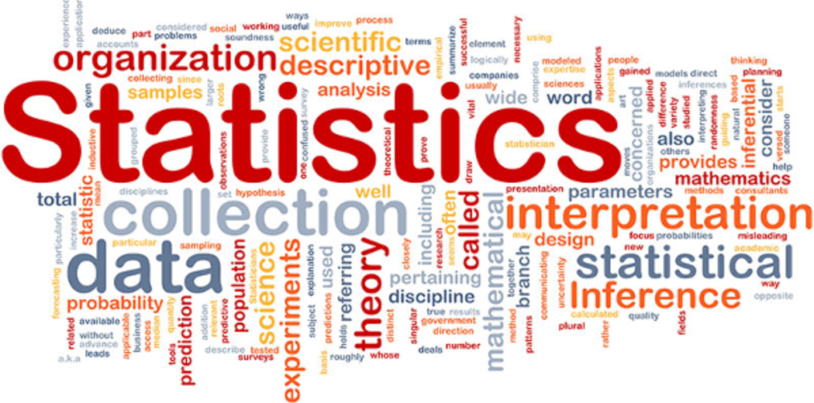
Statistics for Data Science

Slide 2
Content
What is Statistics
Basic Terms of Statistic
Measures of Central Tendency (Mean, Medium, Mode)
Measures of Dispersion (Range, Variance, Standard Deviation, CV)
Box Plot
Skewness & Kurtosis
Percentile/ Quantile
Chebyshev’s Theorem
Correlation and Covariance
Definition
Concepts
Examples
Charts

Slide 3
Content
1
2
3
What is Statistics?
Basic Terms
and Concepts
Measures of Central Tendencies
4
5
6
Measures of Dispersion
Skewness & Kurtosis
Chebyshev’s Theorem

Slide 4
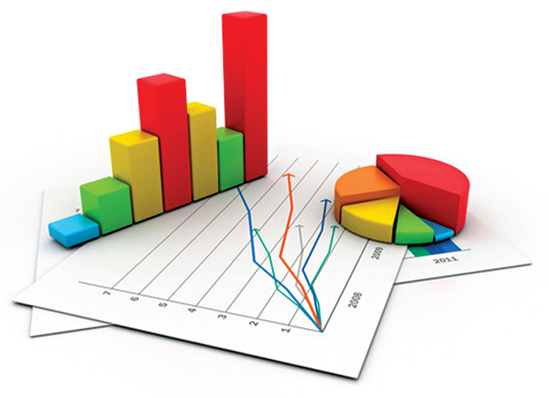
What is Statistics?
Science concerned with developing and studying methods for
Collecting,
Analyzing,
Interpreting and
Presenting of empirical data
Also called the Science of data and information
Form of mathematical analysis that uses quantified models, representations and synopses for a given set of experimental data or real-life studies
Studies methodologies to gather, review, analyze and draw conclusions from data.
Two branches -
Descriptive statistics
Inferential statistics
The word Statistic is derived from Italian word ‘stato’ which means state and ‘statista’ refers to a person involved in the affair of the state. Therefore, statistics originally meant the collection of facts useful to the statista.

Slide 5

Data and Information
Data are a collection of unrefined facts and figures that do not have any added interpretation or analysis. These are the observed values of a variable, at a specific observational Unit.
Observed data are a measurement of a variable, in a given state. For instance, the height of a person (at a particular point of his life), the weight of a package, the pressure of a riveting machine, etc., are the observed data.
Data can be of different types like - Numerical and Categorical. Further they can be Nominal, Ordinal, discrete and Continuous.

Slide 6
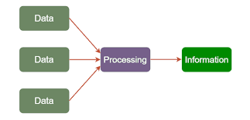
Data, Information and Statistic
Information, retrieved from the data, is a logical interpretation and/or statement which can be observed from the data.
Statistic is a function which takes values observed in a sample as input and gives a number with some meaning/information about the data as output. It is a fully computable quantity which can be obtained from the data. A statistic is based on logical reasoning, e.g., mean gives the average, and standard deviation gives a measure of variation in the sample.

Slide 7
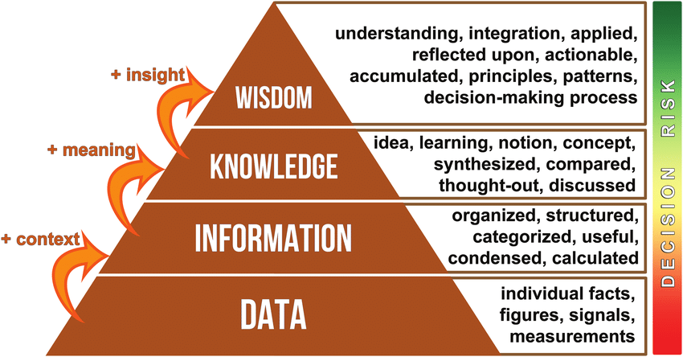
Data, Information, Knowledge and Wisdom Hierarchy

Slide 8
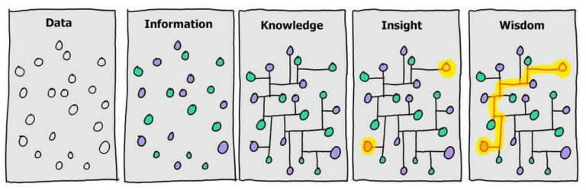
Data, Information, Knowledge Wisdom

Slide 9
Descriptive Statistics
Statistics
Descriptive
Inferential
Describes and summarizes the data
Measures of
Central Tendency
Measures of
Dispersion
Shapes of
Distributions
Charts &
Graphs
Mean,
Median,
Mode
Variance
Standard Deviation
Range, Inter-Quartile Range
Count, Maximum & Minimum
Number of Peaks
Symmetry
Skewness &
Kurtosis
Histograms
Bar Charts
Line Charts
Pie Charts
Box & Whiskers
Scatter Plots
Heat Maps

Slide 10
Inferential Statistics
Descriptive
Inferential
Use Sample statistics to make
predictions about Population
Sample Statistic are Sample Mean (x-bar) and Sample SD (s)
Analyse
Population
1. Take Samples
2. Analyze Samples
Apply Sampling Techniques
Sample
3. Draw inferences, estimates & conclusions about the populations
Inferences
Population Parameters are Population Mean (μ) and Population SD (𝛔)

Slide 11
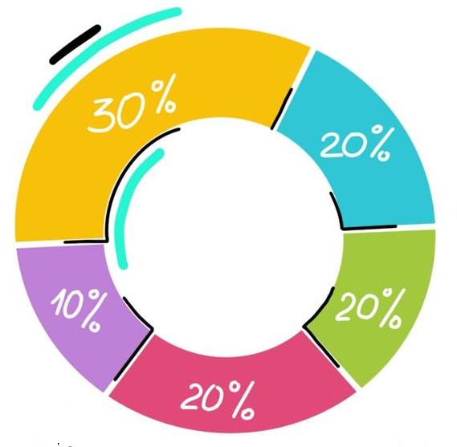
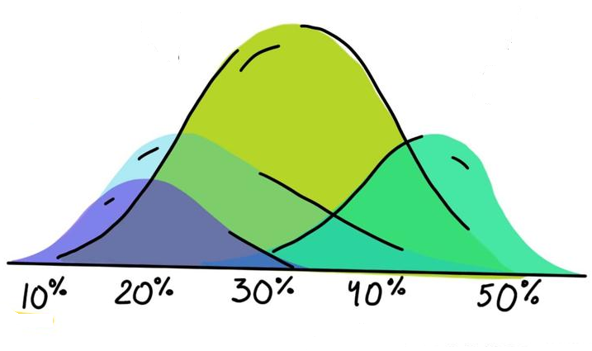
Basic Concepts for Statistics
Types of Statistics
Descriptive Statistics | Inferential Statistics
Method of organising, summarizing and presenting data in an informative way | Make inferences and draw conclusions about the ‘Population’ on the basis of ‘Sample’
Describes the target ‘Population’ | Make inferences from ‘Samples’ and generalize then on the ‘Population’
Describe historical data (which already exist) | Make conclusions about the ‘Population’ which is beyond the data that is available
Tools - Measures of Central Tendency (Mean/ Median/ Mode), Spread of Data (Range, Variance, Standard Deviation) | Tools - Hypothesis, ANOVA, Chi Square, Regression Analysis
Final results are in the form of charts, tables & graphs | Final results are in the form of probability scores

Slide 12
Types of Data/ Variables
Data Types
Qualitative | Quantitative
A variable that describes a Population/ Sample element. Arithmetic operations such as additions and averaging do not apply to such variables | A variable that quantifies a Population/ Sample element. Arithmetic operations such as additions and averaging apply to such variables
Attribute or Categorical Variable | Numeric Variable
Eg - Color or Type of Product Category sold Boolean (Yes/ No, True/ False) Customer Type (Male/ Female/ Kids) Ordered data (High/ Medium/ Low; Big/ Small; First/ Second/ Third) Location of Delivery of Order | Eg - Height Weight of Men/ Women Sales Revenue Count of footfall in a mall No of Beds in Hospital No. of Flights took off in each hour of day

Slide 13
Types of Variables
Data Types
Variable
Numeric
Categorical
Continuous
Discrete
Nominal
Ordinal
Numeric (Quantitative) | Categorical (Qualitative/ Attribute)
Numeric variables have values that describe a measurable quantity as a number, like 'how many' or 'how much' Between any 2 continuous values, there can be infinite number of more data points. They are always essentially numeric Eg - Sales in $ ($ 530,234.5), Height (5’7.5”), Distance (3.14 kms) | A variable that describes a population element. Arithmetic operations such as additions and averaging does not apply to such variables. Categorical variable has values that you can put into a countable number of distinct groups based on a characteristic. If the variable has a natural order, it is an ordinal variable

Slide 14
Basic Concepts for Statistics
Types of Variables
Variable
Numeric
Categorical
Continuous
Discrete
Nominal
Ordinal
Numeric (Quantitative) | Categorical (Qualitative/ Attribute)
Continuous Numeric variable: A numerical variable that can take values on a continuous scale (e.g. age, weight). Discrete Numeric variable: A numerical variable that only takes on whole numbers (e.g. number of visits) | Nominal variables have two or more categories and no natural order to these categories. They are named (Nominal comes from Latin meaning pertaining to names) Ordinal variables have at least three categories and the categories have a natural order. The categories are ranked but the differences between ranks may not be equal.

